Slide 1
Secure Data Hiding in Image Using Steganography
CAPSTONE PROJECT
Presented By: Jay Vilas Chaudhari
College Name: Shri. Vile Parle Kelavani Mandal’s Institute of Technology.

Slide 2
OUTLINE
Problem Statement
Technology used
Wow factor
End users
Result
Conclusion
Git-hub Link
Future scope

Slide 3
Problem Statement
Sensitive information shared digitally is vulnerable to cyber threats and unauthorized access.
Traditional encryption methods can be detected and targeted by attackers.
There is a need for a covert and secure method to protect confidential data.
Steganography allows hiding secret messages inside digital images, making them nearly undetectable.
Existing solutions lack password protection, reducing their security.
This project aims to develop a Python-based steganography system with:
- Image-based data hiding - Encryption for added security - Password protection for controlled access

Slide 4
Technology used
Programming Language: Python – for implementing steganography and encryption algorithms.
Library: OpenCV – for image processing and manipulation.
Cryptography Module – for securing hidden messages with password protection.
Python IDLE – for writing and executing the code.
GitHub – for version control and project hosting.

Slide 5
Wow factors
Invisible Data Hiding – Secret messages are embedded within images without altering their visible appearance.
Password Protection – Ensures only authorized users can access the hidden message.
Lightweight & Fast – Efficient processing with minimal impact on image quality.
Supports Multiple Image Formats – Works with PNG, JPG, and other common formats.
Modular Design – Separate encryption and decryption scripts for better security and usability.
Real-World Application – Can be used for secure communication, watermarking, and data protection.

Slide 6
End users
Cybersecurity Professionals – For secure data transmission and covert communication.
Journalists & Activists – To protect sensitive information from surveillance.
Government & Defense Agencies – For confidential data sharing and secure messaging.
Corporate Organizations – To safeguard trade secrets and internal communications.
Forensic Experts – To hide and retrieve critical evidence securely.
Individuals & Researchers – For personal privacy, secure file sharing, and cryptography research.

Slide 7
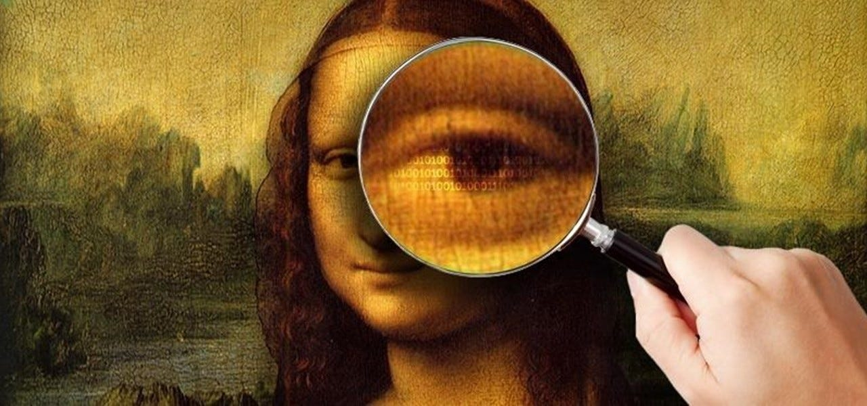
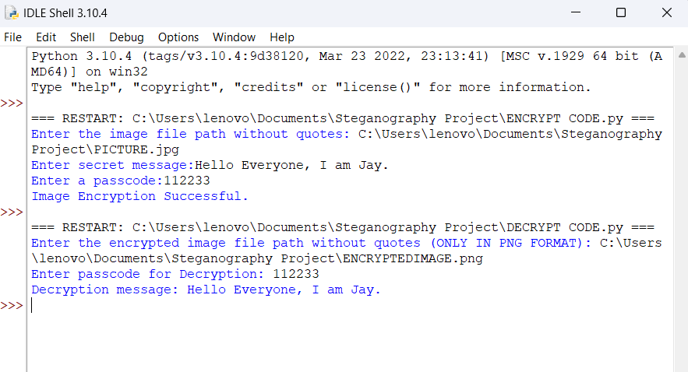
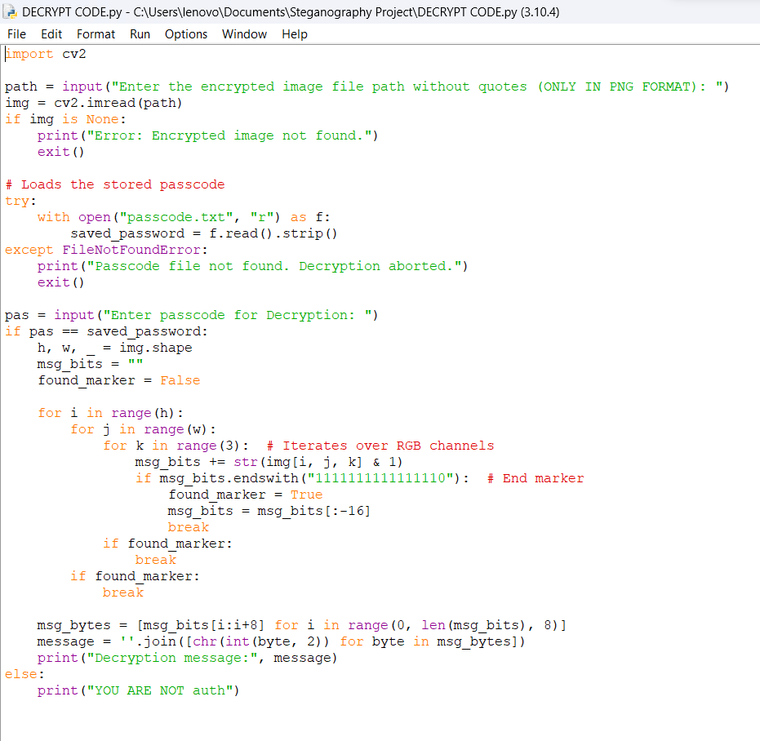
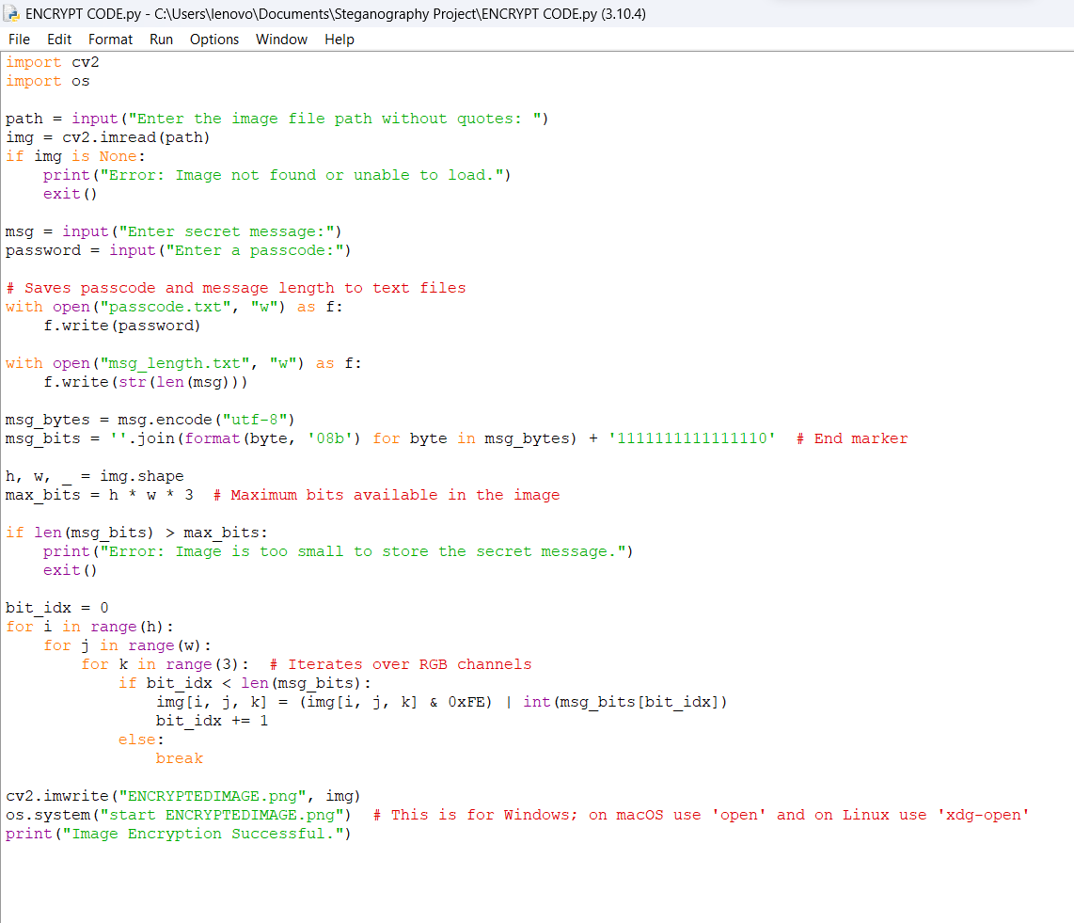
Results
Original Image – 118 KB Encrypted Image – 1367 KB

Slide 8
Conclusion
This project demonstrates how steganography can be used to securely hide sensitive information within images.
By integrating encryption and password protection, the system ensures that only authorized users can access the hidden data.
The use of Python, OpenCV, and cryptography libraries makes the solution efficient, lightweight, and practical.
This technique has real-world applications in cybersecurity, secure communication, digital forensics, and data protection.
Future improvements can include support for audio/video steganography, AI-based enhancements, and a user-friendly GUI.

Slide 9
GitHub Link
https://github.com/Jay-proj/Steganography-Project.git

Slide 10
Future scope
Advanced Encryption Techniques – Implement stronger encryption algorithms for enhanced security.
Audio & Video Steganography – Extend the project to hide data within audio and video files.
AI & Machine Learning Integration – Detect and counteract steganalysis techniques used for uncovering hidden data.
Cloud-Based Implementation – Enable secure steganography services accessible from anywhere.
Mobile Application – Create an Android/iOS app for on-the-go secure communication.
Real-World Applications – Adapt for cybersecurity, digital watermarking, and secure document transmission.

Slide 11
THANK YOU

